Slide 1

Shell Bootcamp 2024 3 Reflections for Week 1
Aayush Dhondiyal
Date : 30-Aug-2024

Slide 2
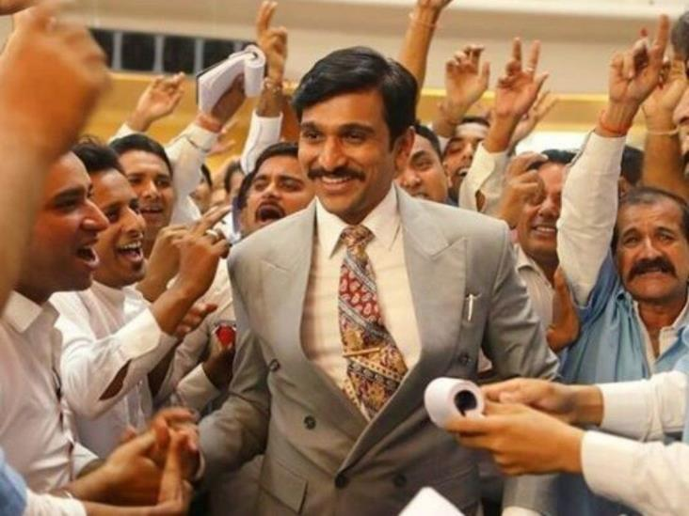
About Me
Stop Complaining, Start Working!
A phrase that represents
my motto in life

Slide 3

My learnings from this week!

Slide 4
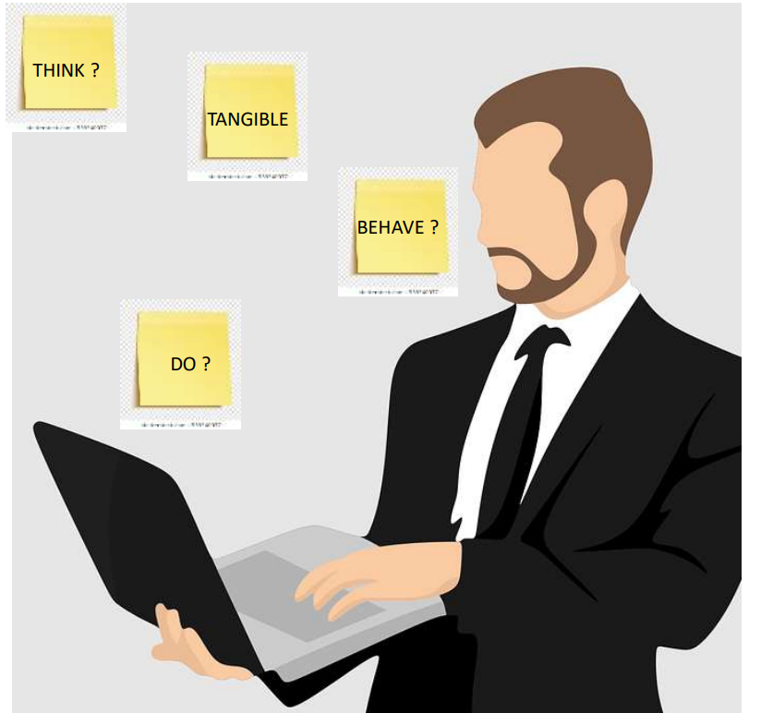
Learning 1 | My takeaways
Key learning
Professionalism is of utmost importance in every corner of the workplace.
Key takeaway
A professional person has an enhanced reputation among colleagues.
How do I personally see this concept implemented in the Energy sector
Professionalism is crucial to ensure safety, efficiency and sustainability. Safety is paramount in the energy sector and all ethical compliances are mandatory.

Slide 5
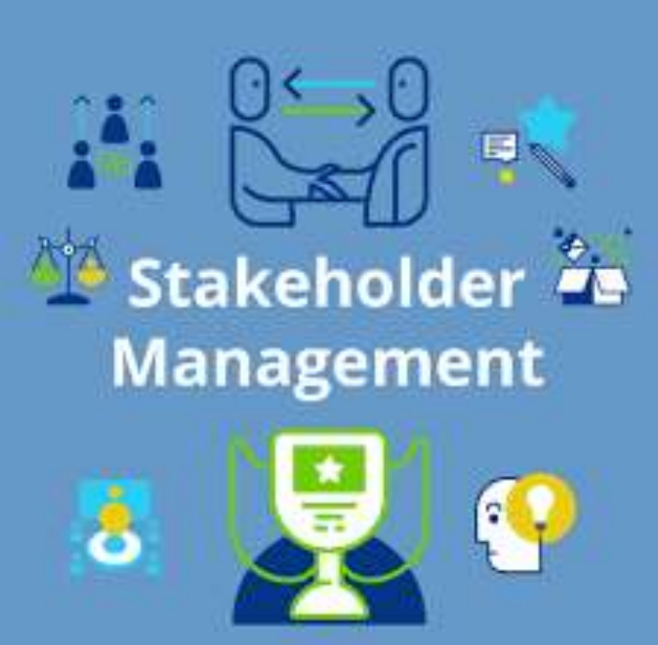
Learning 2 | My takeaways
Key learning
Effective communication with stakeholders helps avoiding conflicts.
Key takeaway
Stakeholders must not be offended at any point during the project lifecycle.
How do I personally see this concept implemented in the Energy sector
Engaging stakeholders early in the project lifecycle helps in understanding their concerns, expectations and potential impacts.

Slide 6
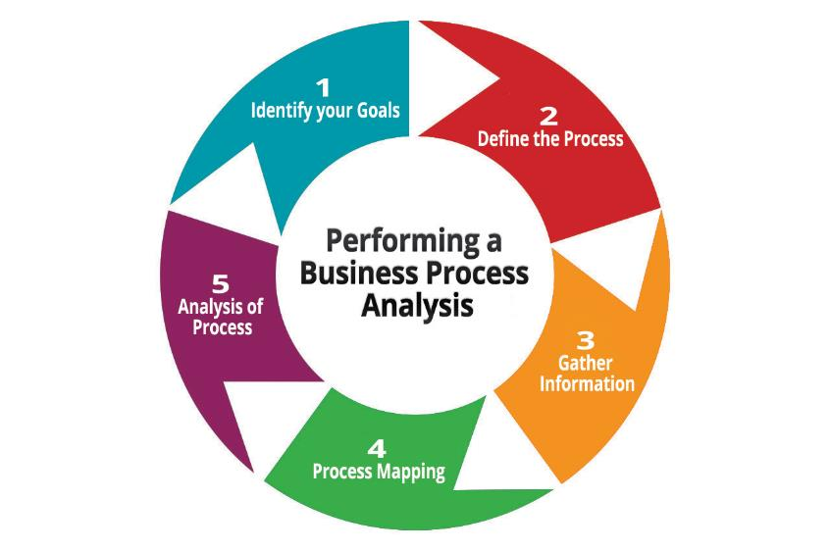
Learning 3 | My takeaways
Key learning
Business Analysis is a critical discipline that helps organizations identify needs and provide solutions to business problems.
Key takeaway
The objective of business analysis is to ensure that solutions are delivered to meet the business needs.
How do I personally see this concept implemented in the Energy sector?
Through proper business analysis, the sector can benefit from improved efficiency, reduced risks and alignment with sustainability.

Slide 7

Relevance of learnings for my organization

Slide 8
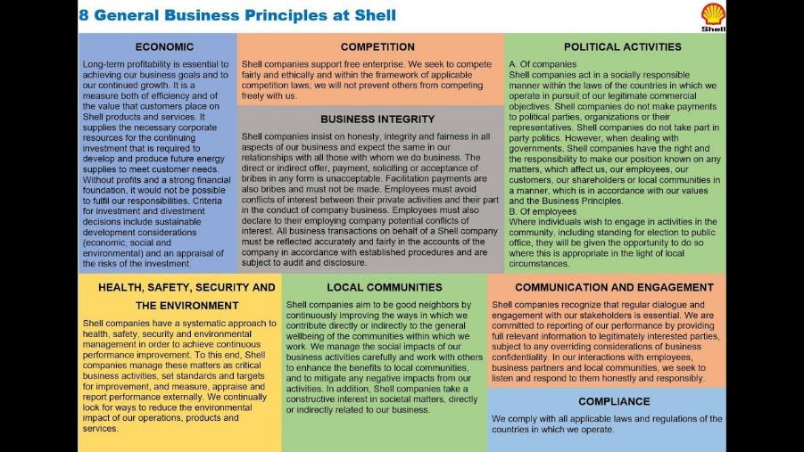
Learning 1 | Relevance for Shell
How I feel Shell implements this learning
The values of Honesty, Integrity and Respect are embedded in the Shell General Business Principles and Code of Conduct which guide employees in their daily activities and decision-making processes.
How I feel Shell benefits from this learning
- These values promote trust, openness, teamwork, and professionalism. It increases the overall efficiency and output of the company.

Slide 9
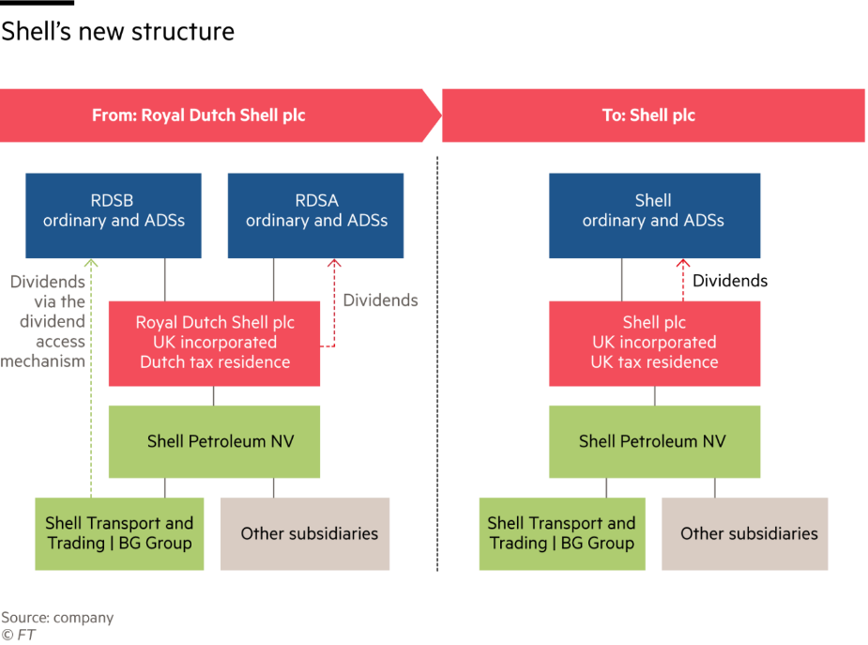
Learning 2 | Relevance for Shell
How I feel Shell implements this learning?
- Shell maintains a transparent communication channel with stakeholders. Shell does intensive risk management as well. There is continuous engagement with stakeholders throughout the year.
How I feel Shell benefits from this learning?
- It leads to enhanced trust and cooperation and reduced risks leading to fewer conflicts and smoother project implementation. It also helps them align its projects with environmental and social objectives.

Slide 10
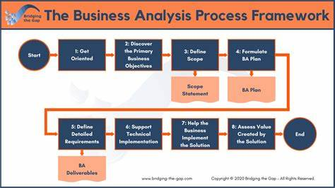
Learning 3 | Relevance for Shell
How I feel Shell implements this learning?
-Shell implements business analysis by leveraging data analytics, conducting risk assessments, engaging stakeholders, focusing on sustainability, and driving digital transformation.
How I feel Shell benefits from this learning?
- These strategies enhance efficiency, reduce risks, improve decision-making, position Shell as a sustainability leader, and boost customer satisfaction.

Slide 11

Challenges in implementing learning

Slide 12
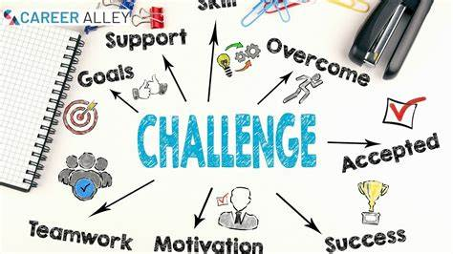
Challenge faced while implementing Learning 1
What were the challenges I faced while implementing Learning 1 and my plan to overcome them?
- No challenges as such when it comes to professionalism. All the guidelines are clear, and I am sensible enough to follow them and become a better professional through the journey.

Slide 13
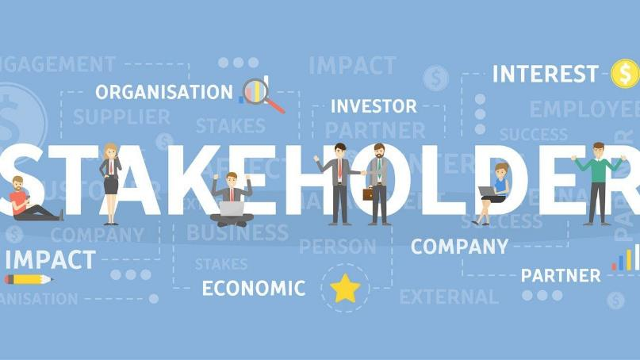
Challenge faced while implementing Learning 2
What were the challenges I faced while implementing Learning 2 and my plan to overcome them?
While having mock sessions on stakeholder management, I was made the CEO. During the session, I got a feedback that I might have been slightly condescending towards a few people while speaking. I decided to take a more polite route thereafter.

Slide 14

Challenge faced while implementing Learning 3
What were the challenges I faced while implementing Learning 3 and my plan to overcome them?
- Business analysis as a concept is something that I love to explore. The real money concept is always engaging. The only challenge is the technical advancement along the lines as well which would be easily done with some practice.

Slide 15

Action Plan

Slide 16
My Action Plan for this Week
Actions
Timeline
Status
Improving Body posture.
Talking to people with more subtilty.
Learning the basics of business analysis.
Getting more in tune with the set of software used by the company.
Soft Skills Sessions
Day 1- Professionalism in workplace
Day 2- Stakeholder Management
Day 3- Presentation Skills
General Training
Day 4- Business Analysis
Day 5- Azure Dev Ops
All tasks completed.
Scope of improvement in operating Azure Dev Ops.

Slide 17

Learning is also Fun!

Slide 18
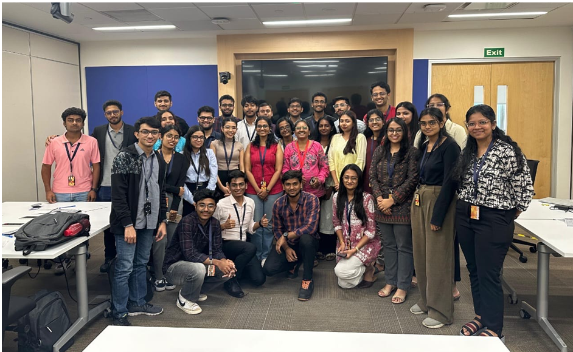
Learning is also Fun!
Details of any group activity
A group activity involved us creating a short play on Growth Mindset v/s Fixed Mindset. The activity involved fun moments along with impromptu dialogues as well.
Details of any funny incident which had an element of new learning for this week’s topic.
A funny impromptu dialogue by a fellow actor displayed the concept of empathy towards others.

Slide 19

Summary
Quick summary
The soft skills sessions helped focus on multiple topics like professionalism, attitude, etiquette, teamwork, presentation skills. The technical sessions have discussed various software engineering basics like SDLC, Agile, SCRUM etc. A basic introduction to Azure Dev Ops was given as well.
Importance of topics of upcoming week
-Technical topics like DBMS, Cloud computing and case studies involving Azure Dev Ops would help in reviving old concepts as well as deeper dive into the relatively newer Azure Dev Ops.
Connectivity of topics from current week
The case study and hands-on practice of Azure Dev Ops would create a better link to the theory discussions done this week through Days 4 and 5.

Slide 20
Thank You

